Slide 1

Optimizing File System Performance in Modern Operating systems
CSA0489- OPERATING SYSTEMS FOR DESKTOP SYSTEMS
Project By:
L Sai manas reddy(192210293)
M. Deepak Reddy(192224108)
M. Bhuvanesh(192224121)
Computer Science & Engineering
Saveetha School Of Engineering
Guided By:
Dr E.K Subramanian
(CourseFaculty)
Operating systems
Saveetha School Of Engineering

Slide 2
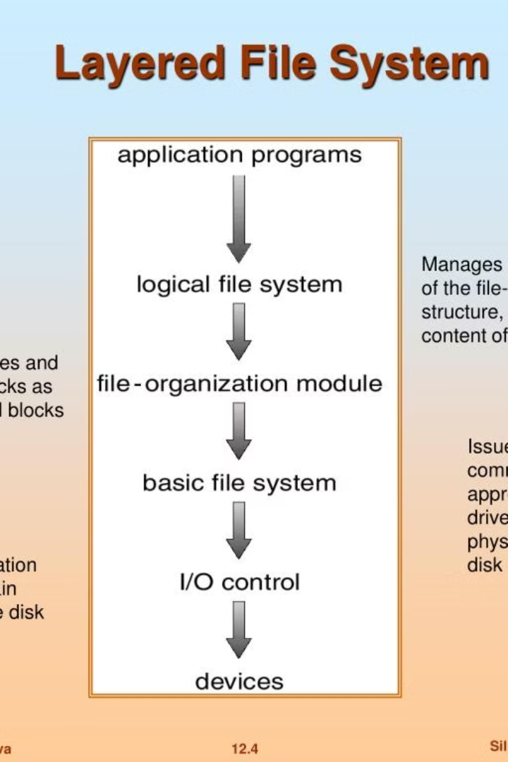
Optimizing File System Performance in Modern Operating Systems
An introduction to the importance of optimizing file system performance, focusing on high-speed data transfer and optimized file storage in modern operating systems.

Slide 3
Understanding Modern Operating Systems
Resource Allocation
File Management
System Architecture
Efficient allocation of resources is essential for optimal file system performance.
Advanced file management techniques play a crucial role in modern operating systems.
Understanding the architecture of modern operating systems is key to performance optimization.

Slide 4
Factors Affecting File System Performance
1
Disk Storage
2
Processing Overhead
Limits on disk storage capacity significantly impact file system performance.
High processing overhead can lead to decreased file system performance.
3
Data Access Patterns
4
Network Latency
The type and frequency of data access patterns affect file system performance.
Network latency has a direct impact on file system performance in distributed environments.

Slide 5

Techniques for Optimizing File System Performance
1
Caching Strategies
Effective caching strategies can significantly improve file system performance.
2
Data Deduplication
Implementing data deduplication methods reduces storage space and enhances performance.
3
Compression Techniques
Utilizing compression techniques can optimize file system performance and storage efficiency.

Slide 6
Case Studies of Successful File System Performance Optimization
Data Center Scenario
Cloud Storage Solution
Distributed File Systems
Real-world implementation of file system optimization in a large-scale data center environment.
Case study demonstrating performance improvement in a cloud-based file system.
Success stories of optimizing file system performance in distributed computing environments.

Slide 7
Conclusion and Key Takeaways
Continuous Monitoring
Regularly monitor file system performance for ongoing optimization.
Adaptive Strategies
Implement adaptive strategies to address evolving file system requirements.
Collaborative Approach
Encourage collaboration between IT teams to share best practices and insights.

